Slide 1
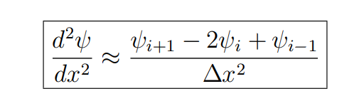
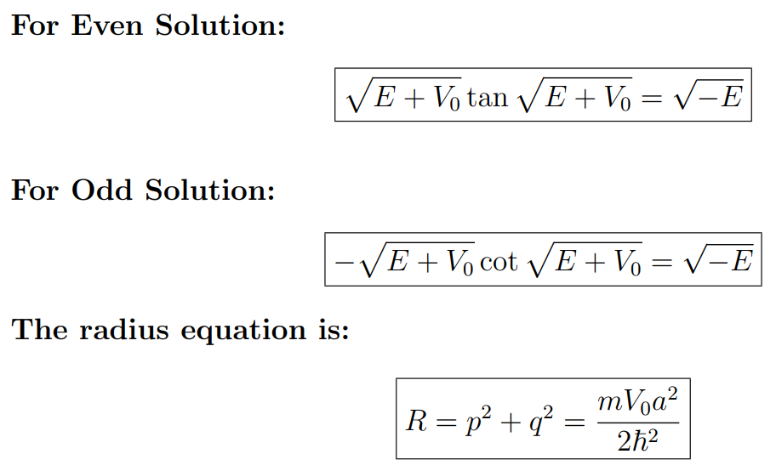
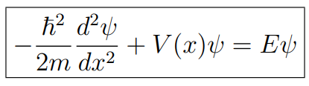
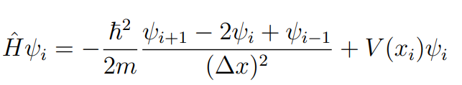
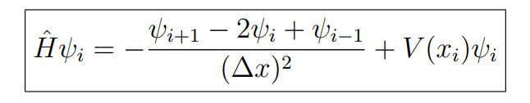
Methodology used for solving
Solving analytically
Upon solving the problem manually, and simplifying it as much as possible we obtained the following three equations:
Solving Numerically
We utilize the finite difference method to solve the second-order differential equation describing the system. For a second-order differential equation, it can be expressed as:
The Schrodinger equation for a particle in one dimension with time-independent potential is given by:
Now we denote the wave function at the i-th grid point as ψi and replacing the finite difference approximation of the second derivative in the Hamiltonian operator equation we get:
We get transcendental equation which are solved graphically.
Simplifying further and taking ℏ/2m = 1, we get,

Slide 2
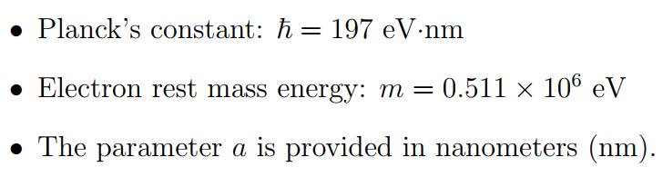
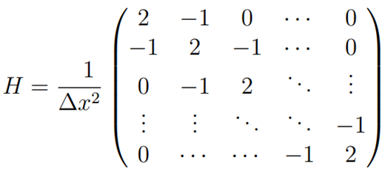
Choice of constants
This equation is forming a Tridiagonal Matrix. By discretizing the space and representing the wave function as an array of values at discrete grid points, we can approximate the behavior of the quantum system and compute its energy eigenvalues and wave functions.
We experimented with:
Continuously changing ‘V’
Continuously changing ‘a’
We observed the results for one specific value of ‘a’ and ‘V’
And finally we worked on minimizing the error
Now by just solving this matrix we get the eigen energies and eigen functions which will give us the wave functions associated with the eigenvalues.

Slide 3
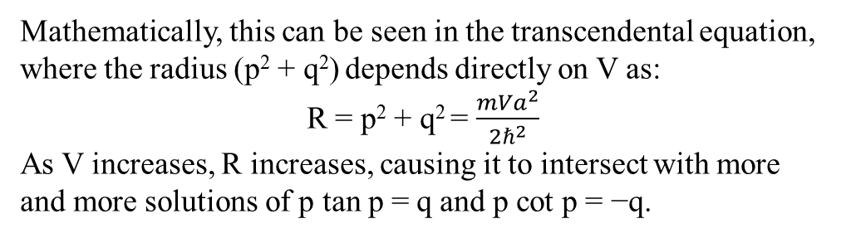
R e s u l t s
Changing the potential (Vo)
As we gradually increase the potential (in the negative direction), we observe the wave function of the particle’s ground state becoming confined between the walls of the potential well. Further increase in potential in the negative direction leads to the observation of higher energy states, meaning more bound solutions will be observed if we keep decreasing the potential below V = 0.
Mathematically, this can be seen in the transcendental equation, where the radius (p² + q²) depends directly on V as:
R = p² + q² = $\frac{{mVa}^{2}}{2ℏ^{2}}$
As V increases, R increases, causing it to intersect with more and more solutions of p tan p = q and p cot p = −q.

Slide 4
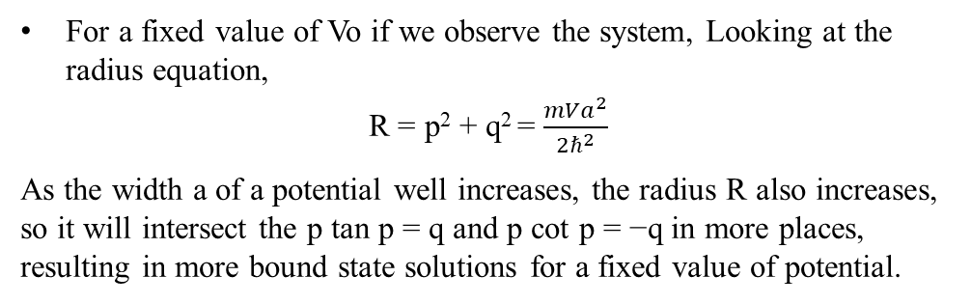
Changing the width (a)
Similar to the potential as we increase the width, we observe the wave function of the particle’s ground state becoming confined between the walls of the potential well. Further increase in the width leads to the observation of higher energy states.
For a fixed value of Vo if we observe the system, Looking at the radius equation,
R = p² + q² = $\frac{{mVa}^{2}}{2ℏ^{2}}$
As the width a of a potential well increases, the radius R also increases, so it will intersect the p tan p = q and p cot p = −q in more places, resulting in more bound state solutions for a fixed value of potential.
One more important insight we can gain from the radius equation is that as the equation depends on V linearly and depends on the second power of a, so the energy values are more susceptible to change with the change in ’a’ that ’V’.

Slide 5
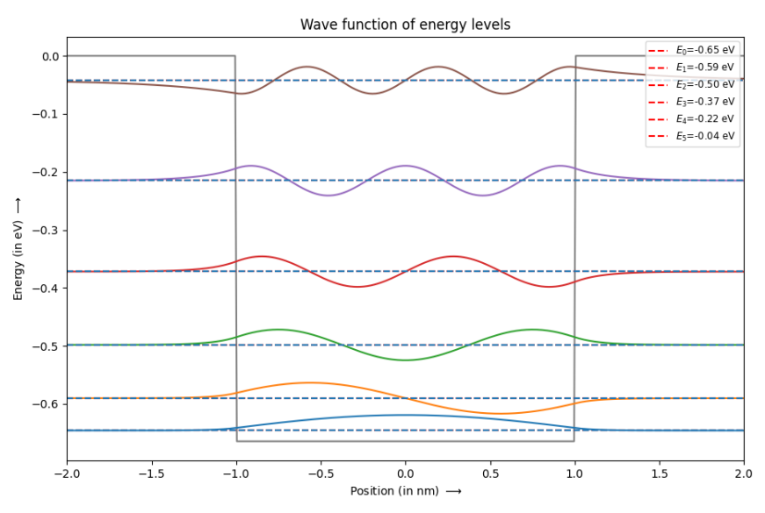
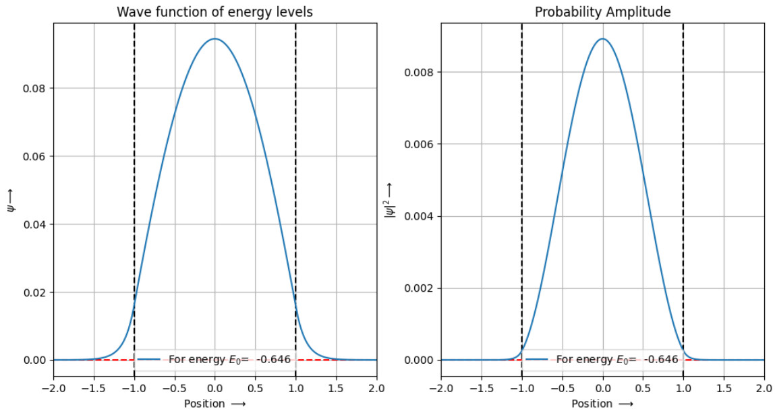
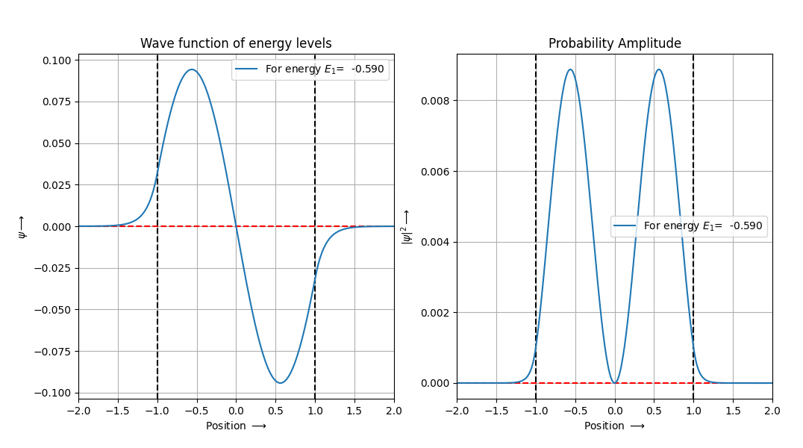
For a specific value of ‘V’ and ‘a’
Energy levels and corresponding wave functions
Wavefunctions and Probability Amplitude
• a = 2 nm ; V0 = −0.66453767 eV

Slide 6
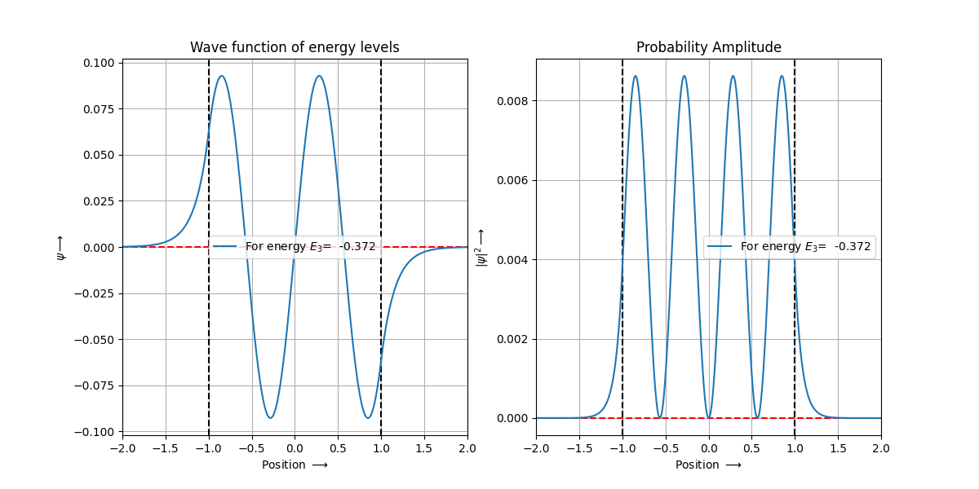
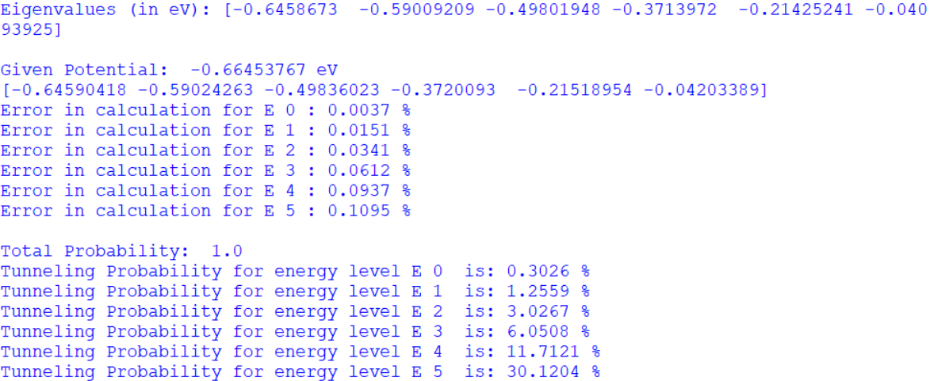
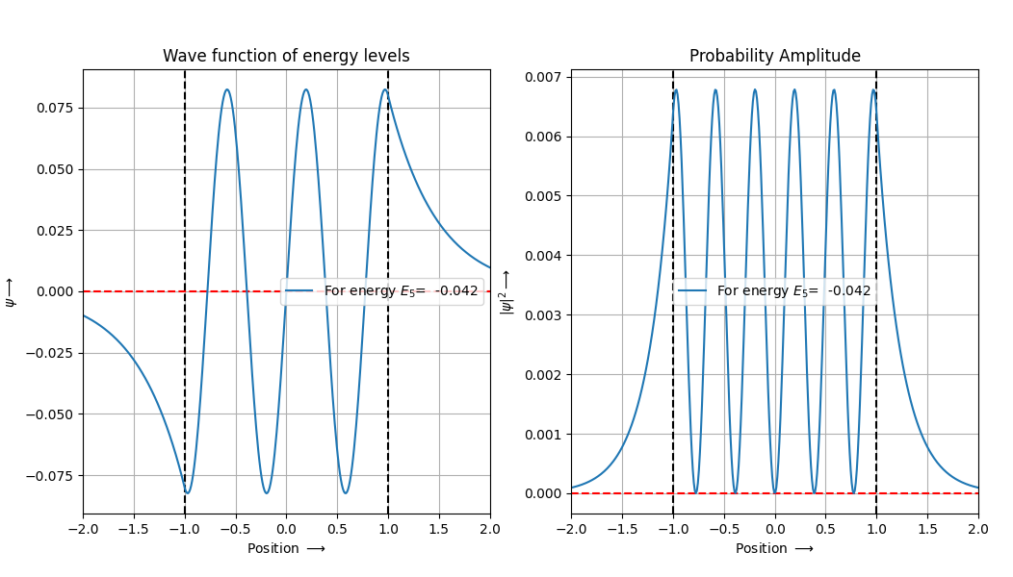
We have also checked the Total probability, which comes to be 1 validating the Normalization of the wave functions.
We were able to see visually the existing tunnelling probability
- As energy value increases and approaches boundary, the
tunnelling probability increases.
We also were able to compare the Analytical and Numarically calculated results .

Slide 7
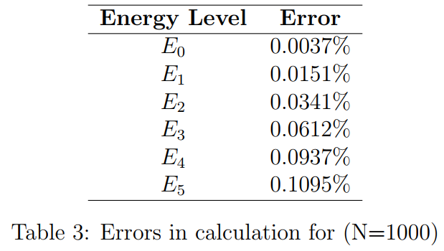
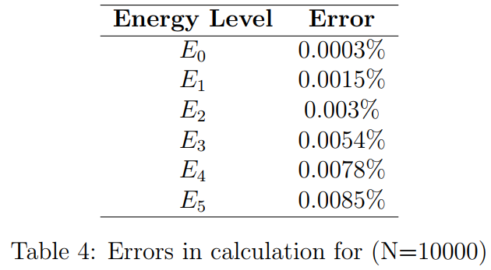
Error Minimizatoin
Remarks on error
But there is a severe drawback.
As to solve the equation, a N x N matrix is formed, so if we increase N the computation power needed increases significantly along with the computation time.
So, to get more accurate result it is a tradeoff between computation time + power and accuracy .
Conclusion
One possible way to increase the accuracy is to increase ’N’ (No of discrete steps)
We also observe a purely quantum behavior, i.e. the tunneling of particles outside the potential well. The probability of tunneling increases for particles in higher energy levels. If we consider the limiting case, if we decrease the potential to negative infinity there will be no tunneling as the walls will be rigid, as we observed in the case of infinite potential well. So, we can say that at higher negative values of V, there will be less tunneling and at lower values of V there will be sufficient tunneling and if we keep on decreasing the potential and go outside the well the tunneling will be 100 % resemble the behavior of a free particle. This phenomenon is demonstrated both mathematically and through graphical representations.
And certainly the accuracy score increased by almost a 100 fold

